Slide 1

Django Learner Lab
Part 2
Getting started with remote access,
backend data modeling, and API endpoints

Slide 2
Why Do This?
This can be the part of the presentation where you introduce yourself, write your email…

Slide 3
Table of Contents
01
02
03
04
05
06
Setup a VM with Remote Access
Clone & Access Learner Lab
Explore ORM Functionality
API Endpoints & Testing
Generate API Documentation
Start a New Project

Slide 4

01
Setup a VM with Remote Access

Slide 5
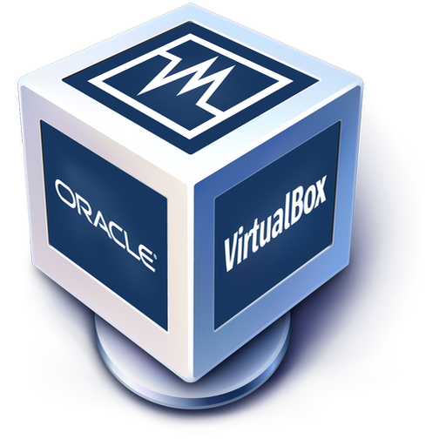

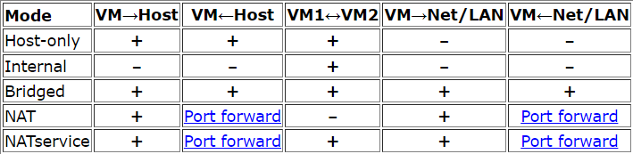
Install Virtualization Software
VirtualBox: https://www.virtualbox.org/
Vmware: https://www.vmware.com/products/desktop-hypervisor.html
Virtual machine networking considerations:
https://www.virtualbox.org/manual/ch06.html
Speaking of craters, many of them were named after artists or authors who made significant contributions to their respective fields. Mercury takes a little more than 58 days to complete its rotation, so try to imagine how long days must be there! Since the temperatures are so extreme and the solar radiation is so high, Mercury has sadly been considered to be non-habitable for humans
# Black boxes like this represent the Linux terminal either directly on the VM or through the IDE

Slide 6
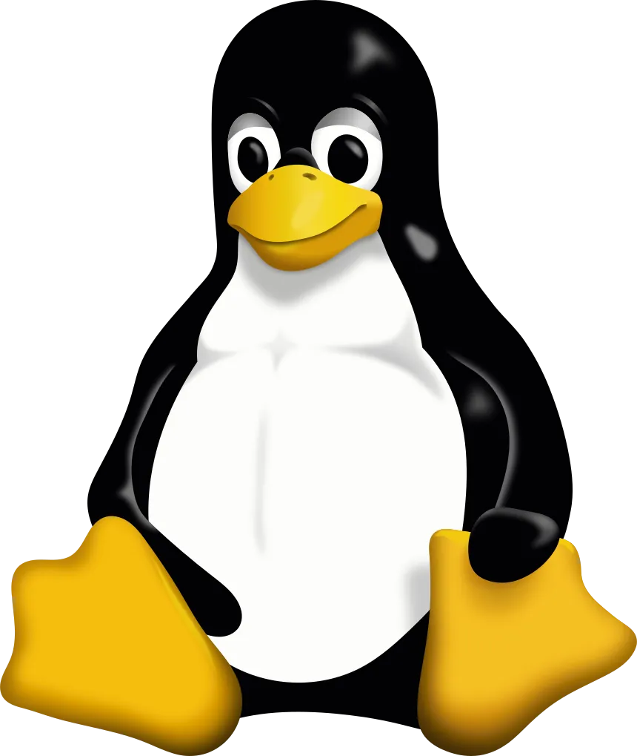


Configure a Virtual Machine
Linux Server
Minimum Requirements
Lightweight
Low requirements
CLI only
Ubuntu popular choice
Download Ubuntu: https://
Storage: 20g
RAM: 2g
CPUs: 1
# install openssh to enable remote connections
sudo apt install openssh-server
# discover your IP address
ip a
Notes:
ENABLE REMOTE CONNECTIONS ON DJANGO SERVER (VM)
Install the OpenSSH server, which is required for remote connections.
> sudo apt install openssh-server
This command will display the IP address (eg: 192.168.0.40)
> ip a

Slide 7
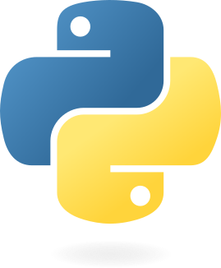
Install Python, pip, & venv
https://www.python.org/downloads/
Using ‘python3’ on linux/mac - On many Linux distributions, python typically refers to Python 2.x, while python3 explicitly calls Python 3.x. Many modern Linux distributions have started to phase out Python 2, and in some cases, python may now point to python3.
Use ‘python –version’ to detect what that command uses (if it is python 3.10.12 for example)
Use ‘python3 –version’ to detect what that command uses
Do you know what helps you make your point crystal clear? Lists like this one:
what is python/what defines it (dynamically typed, interpreted language, high level)
what is a virtual environment and benefits/how to use
And the
Same with install, newer package managers will point python to 3 though some older ones will point python to 2 so you can explicitly state the version you want:
Linux – apt package manager (Debian):
sudo apt install python3
Notes:
When downloading python on Windows, make sure to tick the box at the bottom! (Add python to PATH)

Slide 8

02
Clone & Access Lab Projects

Slide 9
Working With Repo Workflow
Step 1
Step 2
Step 3
Step 4
Create a ‘git’ directory in your home directory
Clone the repo to the git directory
Move to the cloned repo and create a Python venv
Activate the venv and install the requirement.txt
Notes:
After the django server VM installation is complete
CREATE A DIRECTORY FOR GIT REPOSITORIES IN HOME
Mkdir git
Cd git
CLONE THE REPO
Git clone …etc

Slide 10
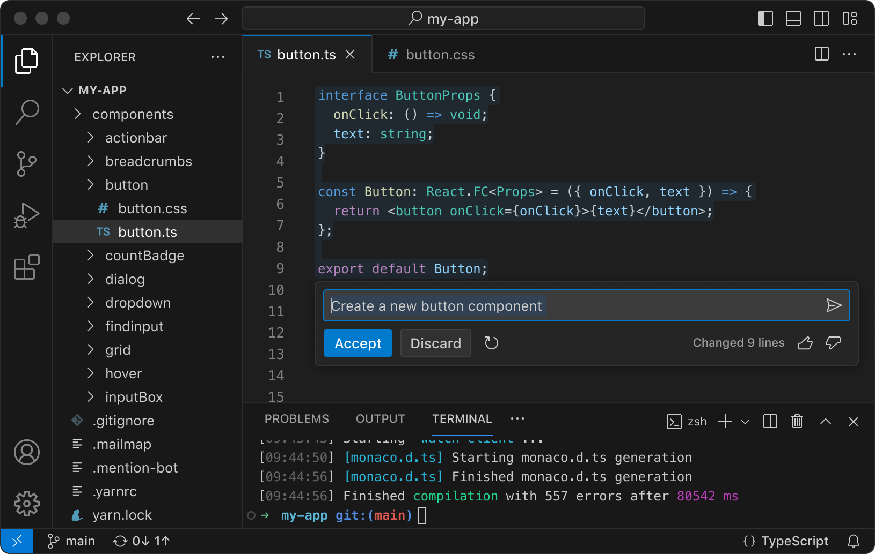
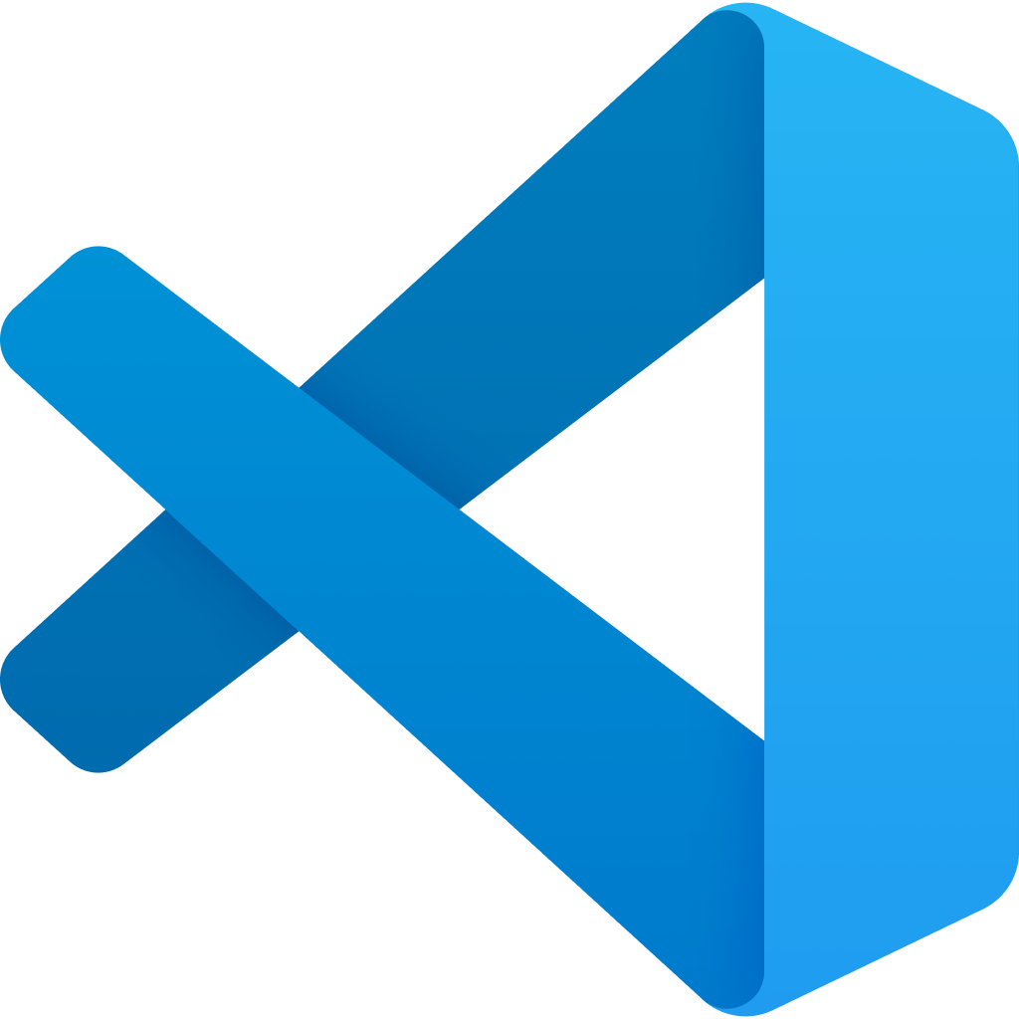
Use VS Code to Access Labs
Selected Extension
Files/Code
Labs:
sql_ex
nosql_ex
Using venv’s with terminal vs. VS Code Python Environment extension. We’ll use terminal/manual way for this lab so it is clear what venv is active.
Recommend installing Django/Python extensions in ssh connection for syntax highlighting, ai-assisted suggestions and code snippet benefits: Python, Python Extension Pack, Pylance
Extensions
Terminal
Notes:
CONNECT FROM HOST MACHINE WITH VS CODE
Install Remote Explorer extension
Go to the Remote Explorer tab and click the ‘+’ to add a new address. A input field will drop down at the top – input the command to connect to the target machine: ssh <username>@<Django-server-ip> -A
You’re given the choice of which config file to update. Choose the one for your user, eg: C:\Users\Luke\.ssh\config
This adds the Django server address to the config file. To see it under the SSH listings, you will need to refresh the list by clicking the refresh button for ‘REMOTES TUNNELS/SSH’, and then the drop down arrow for SSH.
You should see the IP of the server, choose to either connect in the current window or open a new one.
Another input field will drop down from the top – enter the password for the Django server user.
The terminal will now be connected to the Django server. To use the File explorer, lick ‘Open Folder’ and choose the directory you want to open. You can choose the users home directory but to simplify the display, it’s recommended you open the directory where you created the Django project (or where you cloned the learnerlab repo).
You will need to input the password for the user once more in the drop down input field at the top.
To close the remote connection, click the SSH: <Django-ip> in the bottom left corner, ‘close remote connection
Not all extensions will be useable when connected to remote server as they need to be installed locally. By visiting the extensions tab you will have the option to ‘install shh: <ip your connected to>. This will install the extension for the user on the machine you’re connected to (not in the venv, so it will be available to all projects on the machine).
To enable remote connections to the running Django server: Add the Django server IP to the settings.py under ALLOWED HOSTS (or add ‘*’ to make accessible from any machine). This will enable you to visit the admin page from other machines.
Superuser: lukewait
Password: Passw0rd1!

Slide 11
Repo Contents and Django Project Files
Docs
sql_ex
Learner lab documentation
Command cheat sheets
Sql_ex, no_sql ex
What is in the projects: sqlite db, manage.py, setting.py, models.py etc
Docs
nosql_ex
Jupiter is a gas giant and the biggest planet in the Solar System. It’s the fourth-brightest object in the night sky and was named after a god
Saturn is a gas giant and has several rings. It’s composed mostly of hydrogen and helium. It’s the sixth planet from the Sun

Slide 12
Out-of-the-box Django Setup
New Project
Settings
Apps
manage.py
db.sqlite3
Is named by the user when starting project (config in examples). Folder contains global settings for project, namely settings.py and urls.py.
asgi.py
settings.py
urls.py
wsgi.py
Is named when creating an app (main_app in examples). Folder contains settings for individual app.
migrations
admin.py
apps.py
models.py
tests.py
views.py
Provides a host of functions for managing the Django project including:
runserver
makemigrations migrate
create superuser
shell environment etc
Created when you initialize an admin user or migrate models from model.py. When using an external database for managing admin users and data storage this file will not exist.

Slide 13
Considerations for Project Structure
Flexibility
Logically Group
Modularity
Hierarchical structure can improve options for structure, such as by having a urls.py in the global config directory that points to urls.py in each app with the app name as prefix ‘main_app/’ for example
Separate apps by logical collections of tightly coupled data/tables. In relational db, this could be tables that are closely tied together by relationships. With nosql, collections tend to be decoupled by nature and would benefit from having an app for each collection.
Reusable code
Clean single focus purpose: in larger projects with many views per app, it might be worth separating apiviews and having 2 view files – views.py and apiviews.py

Slide 14

03
Explore ORM Functionality
Notes:
More reading
https://docs.djangoproject.com/en/4.0/topics/db/queries/
https://docs.djangoproject.com/en/4.0/topics/db/sql/

Slide 15
Enforcing ORM Requirements
Models <-> Tables
Write models/schema with Django and make migrations to write to sqlite builtin db
Common approach if starting with new db
Use importdb to write to Django models from existing db/schema.
This includes external db’s
Common approach when using an existing db in a project
How to connect external db
- settings.py
Both methods of model -> db or db -> model is viable, as long as they match and are n-sync
Speaking of craters, many of them were named after artists or authors who made significant contributions to their respective fields. Mercury takes a little more than 58 days to complete its rotation, so try to imagine how long days must be there! Since the temperatures are so extreme and the solar radiation is so high, Mercury has sadly been considered to be non-habitable for humans
ORM explanation
Provided consistency between data models and database
Essential for relational dbs
Provides a way to query database with python/through Django
Similar to SQL
python manage.py makemigrations
python manage.py migrate
python manage.py importdb
Notes:
Writing models in Django model.py and using make migrations to examine model.py and create schema
OR
Using importdb to examine database and write the schema to model.py (Remove managed = False if you want Django to auto-manage tables. This will appear on linking/intermediary tables.)
This can be used on the built-in sqlite db as well as external db’s such as mysql or oracle. If using an external db you will need to install the db sdk (such as ‘pip install mysqlclient’) in your python virtual environment and add the db connection config to settings.py, under ‘DATABASES’.
Either way, it is crucial that the database and models match

Slide 16
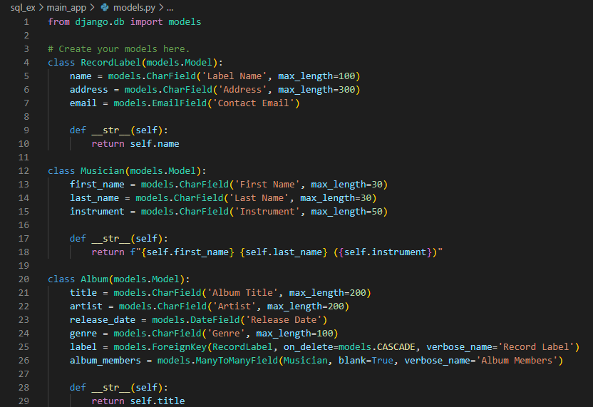
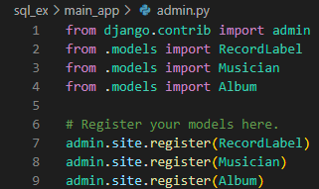
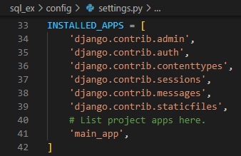
Setup of sql_ex Project
Modified files:
config/settings.py
main_app/models.py
main_app/admin.py
And the most important thing: the audience won’t miss the point of your presentation
Notes:
config/settings.py.
Reference our app (main_app) in the project's settings file under INSTALLED APPS. Remember a project can have multiple apps and they would all need to be declared here.
Here's a working example of how to build up tables with relationships in Django and use ORM capabilities. ORM is portable across a broad range of RDMS and used in a number of development environments, eliminating the need for the developer to redo their code.
Superuser: lukewait
Password: Passw0rd1!
The first thing I did was make the models in the models.py file:
There are two relationships in the above code in the class Album table:
label is a foreign key based on the RecordLabel table (one to many)
album_members is based on the Musician table as a many to many relationship.
You do not need to describe linking tables for the many to many relationships because Django will take care of this in the background.
main_app/Admin.py.
Write the following code to register the models and allow us to interact with our database via the admin portal.
We have now established the models and attached the models to the admin back end, as well as linking our app to the project settings, running the migrations, and then building the database for us. If we were the swap databases, we'd have to do this. We would perform the migrations after the swap, and it would create the database for a new RDMS.
python3 manage.py makemigrations
python3 manage.py migrate
python3 manage.py runserver (for 127.0.0.1)
python3 manage.py runserver <specifyip>:<specifyport>

Slide 17
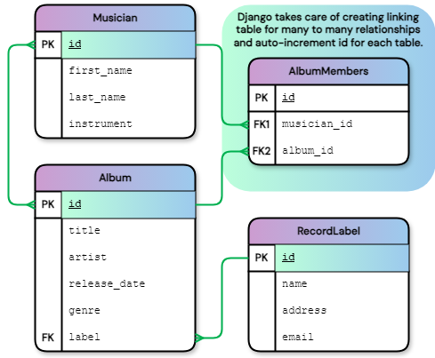
Result of Migrating Model Code to Schema
Entity Relationship Diagram
Advantages
Using Django to create the database schema can be a particularly appealing approach when there is no existing database to import as it simplifies the declaration of fields and relationships. As Django handles the creation of an auto-incrementing Primary Key for tables, these don’t need to be explicitly declared. In addition, linking/intermediary tables required by many to many relationships are handled by Django, only requiring the relationship to declared in one table with reference to the other. A Foreign Key can even reference another table without specifying its PK. These characteristics make it quick and easy to create tables and simplifies relationship requirements. Lastly, you will want your models to match your schema anyway, and this is an effective way of maintaining consistency between the two.

Slide 18
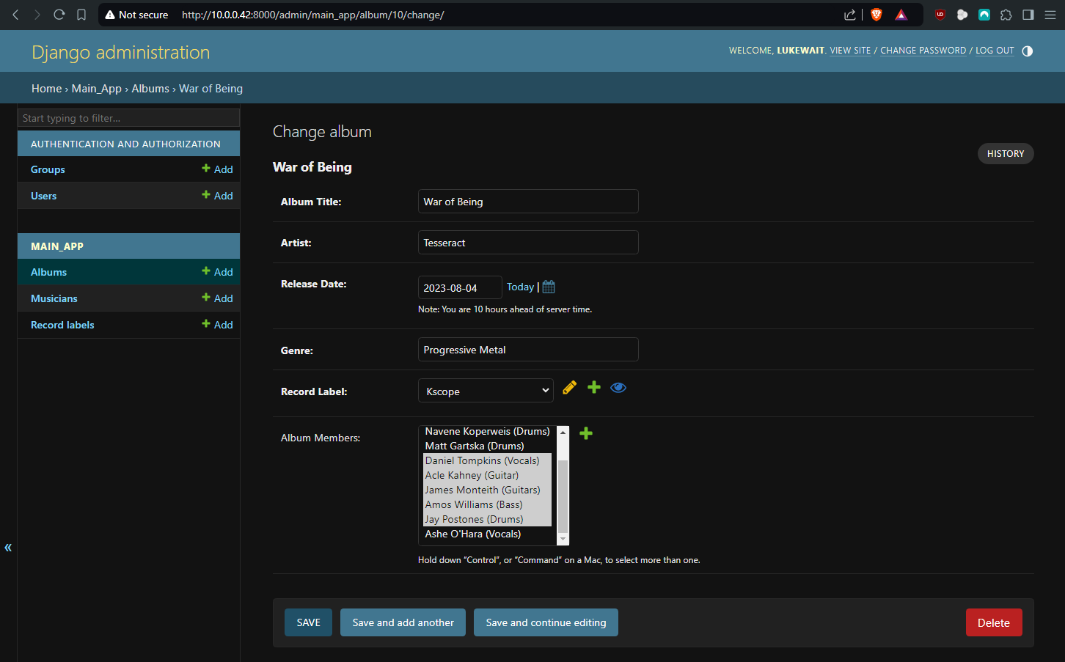
Django Admin GUI
Manage users/groups
Register models with main_app/admin.py
Ensure ALLOWED HOSTS in settings.py allows all with [‘*’] or the specific IP of the machine accessing the portal
# Run server on loopback address 127.0.0.1
python3 manage.py runserver
# Run server on vm ip address and port of your choosing
python3 manage.py runserver <ip>:<port>
Notes:
Provides an easy way to visualize and edit table field data as well as users/groups for authorization
Alternative is to populate db programmitcally or import sql dump

Slide 19
ORM Commands
# Launch the Django shell environment
python3 manage.py shell
# Import all models from main_app
>>> from main_app.models import *
# Get all records from RecordLabel model
>>> print(RecordLabel.objects.all())
<QuerySet [<RecordLabel: Sumerian Records>, <RecordLabel: Century Media Records>, <RecordLabel: Kscope>]>
# Get first two records from RecordLabel model
>>> print(RecordLabel.objects.all()[:2])
<QuerySet [<RecordLabel: Sumerian Records>, <RecordLabel: Century Media Records>]>
# Get all records from RecordLabel and order by name
>>> print(RecordLabel.objects.order_by('name'))
<QuerySet [<RecordLabel: Century Media Records>, <RecordLabel: Kscope>, <RecordLabel: Sumerian Records>]>
Django Shell
Now we're going to utilize the Django shell environment as a scratch area for testing our ORM statements to check if we get the expected results. This is example of code that could be used in your APIView methods. Import statements and variable states will persist until you exit the Django shell environment. Notice when you retrieve entries from a model you get the return string formatted in models.py.

Slide 20
ORM Commands Cont.
# Get all records from RecordLabel model where name is 'Sumerian Records'
>>> print(RecordLabel.objects.filter(name='Sumerian Records'))
<QuerySet [<RecordLabel: Sumerian Records>]>
# Get all records from RecordLabel model where name is not 'Sumerian Records'
>>> print(RecordLabel.objects.exclude(name='Sumerian Records'))
<QuerySet [<RecordLabel: Century Media Records>, <RecordLabel: Kscope>]>
# Get all records from RecordLabel model where id is 2
>>> print(RecordLabel.objects.get(id=2))
Century Media Records
# Case-sensitive: Get all entries from RecordLabel where name is exactly 'Sumerian Records'
>>> print(RecordLabel.objects.get(name__exact='Sumerian Records'))
Sumerian Records
# Case-insensitive: Get all entries from RecordLabel where name is 'sumerian records'
>>> print(RecordLabel.objects.get(name__iexact='sumerian records'))
Sumerian Records
# Get all records from RecordLabel where name contain 'Records' (case-insensitive)
>>> print(RecordLabel.objects.filter(name__icontains='Records'))
<QuerySet [<RecordLabel: Sumerian Records>, <RecordLabel: Century Media Records>]>

Slide 21
ORM Commands Cont.
# Lookup that spans relationships: Get all records of Albums with RecordLabel 'Kscope'
>>> albums = Album.objects.filter(label__name='Kscope')
>>> print(albums)
<QuerySet [<Album: Tesseract: Polaris>, <Album: Tesseract: Sonder>, <Album: Tesseract: War of Being>]>
# Many-to-many lookup: Get all records of Albums featuring Musician 'Ashe O'Hara'
>>> print(Album.objects.filter(album_members__first_name=‘Ashe'))
<QuerySet [<Album: Tesseract: Altered State>]>
# Delete an Album record
>>> album = Album.objects.get(title__exact='Parrhesia')
>>> print(album)
Animals as Leaders: Parrhesia
>>> album.delete()
>>> print(album)
<QuerySet []> # Check the admin portal to confirm the record has been deleted
# Update a RecordLabel record
>>> label = RecordLabel.objects.filter(name__exact='Sumerian Records').update(name='Sumerian Music’)
>>> print(label)
1 # The print value in this case is the number of records that have been updated
>>> print(RecordLabel.objects.all())
<QuerySet [<RecordLabel: Sumerian Music>, <RecordLabel: Century Media Records>, <RecordLabel: Kscope>]>

Slide 22
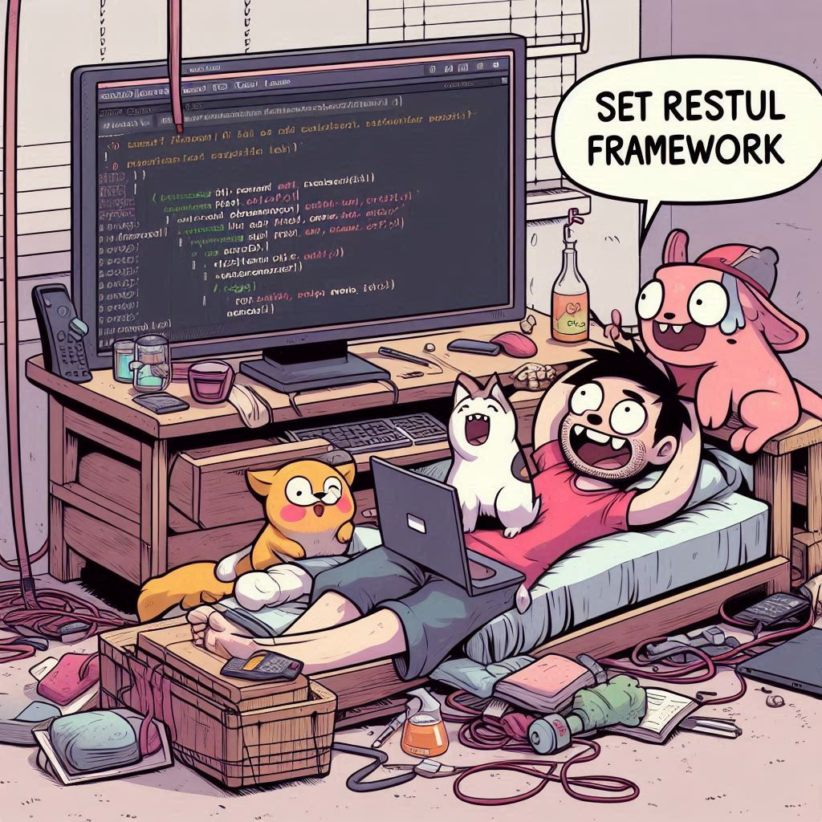
03
Setup RESTful Framework

Slide 23
Django REST Framework Library
Serializers
Permissions
Venus is the second planet from the Sun
It’s the biggest planet in the Solar System
Views/ViewSets
Authentication
Jupiter doesn’t have a solid surface
Saturn is a gas giant and has several rings
Routers
Browsable APIs
Earth is the only planet that harbors life
Despite being red, Mars is actually a cold place
Notes:
Django Rest Framework (DRF) is a powerful and flexible toolkit for building Web APIs in Django. It abstracts much of the boilerplate code required to create RESTful APIs and offers a range of features to make API development more efficient and maintainable.
Key Features of Django Rest Framework
Serializers:
Convert complex data types, such as querysets and model instances, into native Python data types that can be easily rendered into JSON, XML, or other content types.
Validate incoming data and convert it back into complex types after deserialization.
Views and ViewSets:
Provide a way to define the logic for your API endpoints.
APIView provides the base class for all API views.
ViewSets offer a way to combine multiple views for a given resource, such as listing, creating, retrieving, updating, and deleting records.
Routers: Automatically create URL confs for your API, making it simpler to define and manage endpoints.
Permissions: Control access to your API at both the object level and the view level.
Built-in permissions include IsAuthenticated, IsAdminUser, AllowAny, etc.
Authentication: Supports various authentication schemes, such as token-based authentication, session authentication, OAuth, etc.
Browsable API: Provides a web-based interface for testing your API endpoints interactively.
Using filters/ordering on views to enhance versatility of endpoints

Slide 24
How to Install & Setup DRF
Create Serializers
Create Views
Update URLs
Configure Settings
Earth is the only planet known to harbor life
Despite being red, Mars is actually a cold place
Jupiter is the biggest planet in the Solar System
Saturn has a high number of moons, like Jupiter
Notes:
Django Rest Framework (DRF) does not automatically create files like serializers.py or any other specific code or files in your project. The installation process simply adds the DRF package to your Python environment and makes it available for import in your Django project.
What You Need to Do Manually
After installing DRF, you'll need to create the necessary files and structure yourself. Here are the common steps to set up DRF in your project:
Create Serializers:
You will need to create a serializers.py file in your Django app directory where you define your serializers.
Example:
# main_app/serializers.py
from rest_framework import serializers
from .models import RecordLabel, Album, Musician
class RecordLabelSerializer(serializers.ModelSerializer):
class Meta:
model = RecordLabel
fields = ['id', 'task', 'completed', 'timestamp', 'updated', 'user']
Create Views: Create or modify your views.py file to include API views using DRF.
Update URLs: Set up the URL routing in your urls.py files for your app and project.
- Create urls.py in main_app
Configure Settings: Add 'rest_framework' to your INSTALLED_APPS in settings.py if you haven't done so.
Testing: You may want to set up tests for your API endpoints using DRF's testing tools.
Summary
While DRF provides many useful features and tools for building APIs, it requires you to manually define serializers, views, and URLs as per your application's needs. The framework facilitates API development but does not automate file or code generation.
To access the CRUD functions through the REST API, open a new tab in your Ib browser and navigate to http://<ip>:8000/<model>/. This will display a list of entries in the model. Access specific entries with http://<ip>:8000/<model>/<id>

Slide 25
Using Django Auth to Control Views
Users
URLs
Represents a user of the Django Admin system
When used with groups and views, can tailor access/view to specific needs of user
The endpoint that needs to be accessed
Points to a view that provides the CRUD functions
Add a urls.py to apps to separate path in app specific
Groups
Views
A collection of permissions that can be assigned to users
A user can have multiple groups assigned to them
Simplifies permission management
Keeps permission allocation consistent
Models/serializers must be imported
A class represents an endpoint and contains the functions to interact with the models
Notes:
Users permissions in the admin portal pertain to only the admin portal
If you want to apply these permissions to the api views you will need to programmatically check the users permissions and write conditional code
For example, the talent agents only have permission to CRUD the Musician model however they can still access the RecordLabelListAPIView

Slide 26
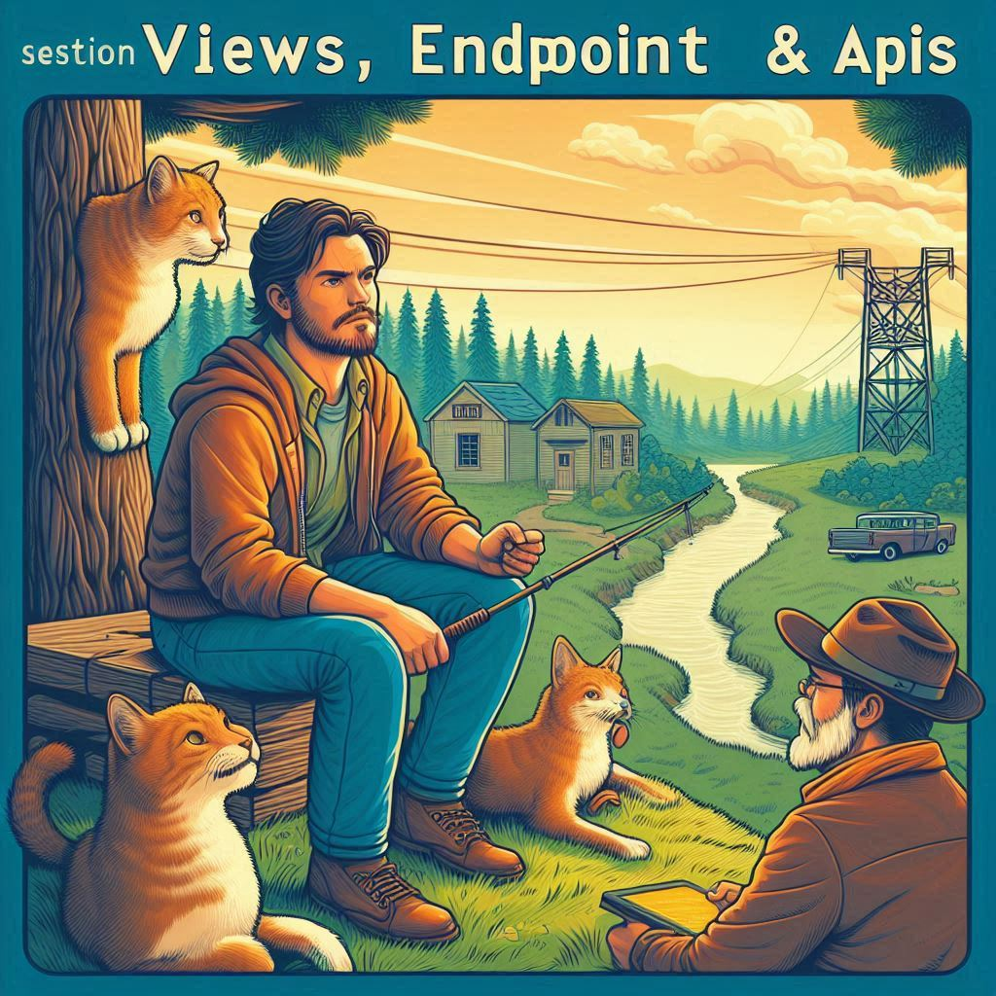
03
Views, Endpoints & APIs
Notes:
Your application API will be a collection of the API endpoints in urls.py that point to API views in view.py.
Difference between regular views (front end rendering) and API views (back end access)
Regular views to return HTML content – return content Using render vs http.response
API views to handle programmatic access to resources – return content using serializer vs json.response
Using them in conjunction – regular view loads html, provides interactive elements via js that can call api endpoints which point to api views, which provide access to resources, which are then returned to the js via serializer (usually json), which then processes the response as needed, and displays it on the HTML page
Django directories – expects htmls to be in main_app/templates/<best to use another folder here to distinguish the contents of this ‘templates’ dir from other apps>/
Expects js and css to be in main_app/static/<same as templates, use another folder to make unique>/
{% load static %} <!-- Loads Django default location for static files such as css, js and image files (main_app/static) -->
<link rel="stylesheet" href="{% static 'main_app/main_app.css' %}">
<script src="{% static 'main_app/main_app.js' %}" defer></script></head>
Explain how a front end framework might fit into django such as react

Slide 27
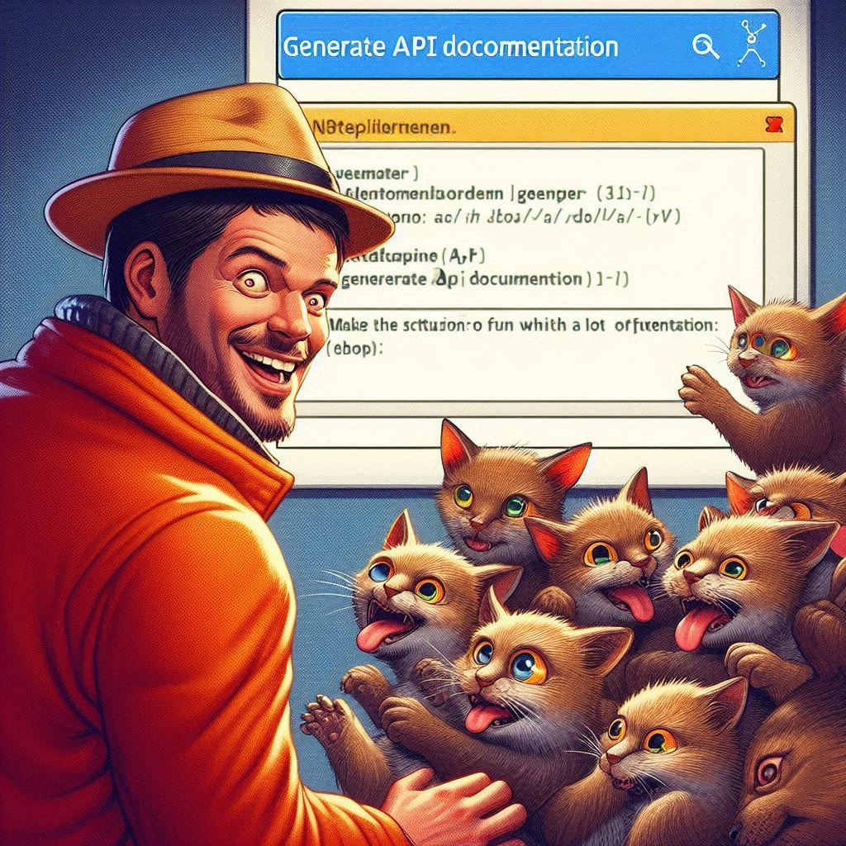
05
API Testing & Documentation
Notes:
How to use the Thunder Client extension in Visual Studio with a DJANGO API, follow these steps:
Install the Thunder Client extension in Visual Studio. You can do this by opening the Extensions panel, searching for "Thunder Client", and clicking "Install".
Open the DJANGO API project in Visual Studio and ensure that it is running. You should see the DJANGO API homepage displayed in your browser.
Open Thunder Client by clicking on the Thunder Client icon in the Visual Studio toolbar.
Create a new request by clicking the "New Request" button. In the "Request URL" field, enter the URL for the DJANGO API endpoint you want to test. For example, if you want to test the "users" endpoint, you would enter "http://localhost:8000/users/".
Choose the HTTP method for your request from the dropdown menu (e.g., GET, POST, PUT, DELETE).
Add any necessary headers or query parameters to your request.
If you need to send data in the body of your request (e.g., for a POST or PUT request), enter the data in the "Body" field.
Click the "Send" button to send the request to the DJANGO API.
The response from the DJANGO API will be displayed in the Thunder Client window. You can view the response headers and body, and use the "Test" button to run tests on the response.
That's it! With Thunder Client, you can easily test your DJANGO API endpoints and ensure that they are functioning as expected.
Or use Postman, it does the thing too.

Slide 28

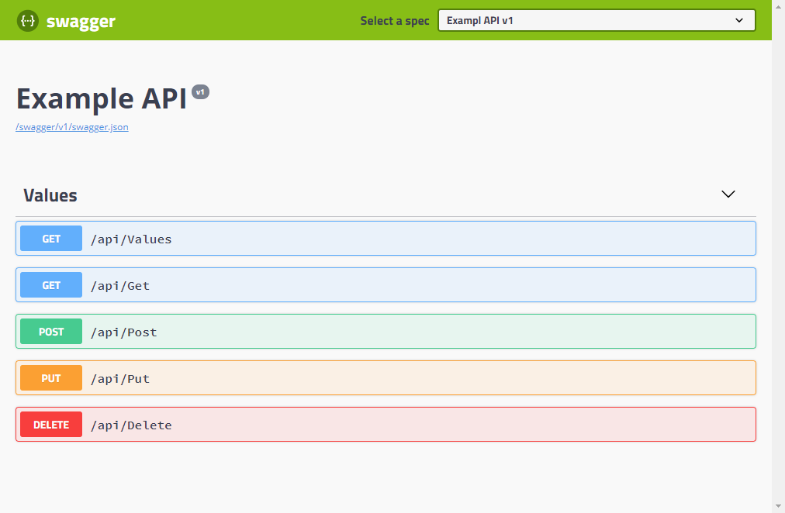
APIs and Documentation
You can replace the image on the screen with your own work. Just right-click on it and select “Replace image”
Notes:
Cover Swagger and OpenAPI explanation
Redoc is similar to Swagger and is another option to display api documentation with openapi specifications.
I recommend using drf_yasg for generating API documentation in Django projects. It is well-maintained and supports the OpenAPI specification, which is a widely adopted standard for API documentation. Here’s a step-by-step guide on how to set up drf_yasg in your Django project:
Install drf_yasg:
pip install drf-yasg
Update your urls.py file:
If you're working with a project-level urls.py, add the following configuration. If you're working within an app, you can add this configuration to the app’s urls.py, but the project-level file is more common for such configurations.
from django.contrib import admin
from django.urls import path, re_path
from rest_framework import permissions
from drf_yasg.views import get_schema_view
from drf_yasg import openapi
main_app_schema_view = get_schema_view(
openapi.Info(
title="sql_ex Project API",
default_version='v1',
description="API documentation for all apps present in sql_ex Project",
terms_of_service=None,
contact=openapi.Contact(email='lukewait@outlook.com'),
license=openapi.License(name='MIT License'),
),
public=True,
permission_classes=(permissions.AllowAny,),
)
urlpatterns = [
re_path(r'^swagger/main_app(?P<format>\.json|\.yaml)$', main_app_schema_view.without_ui(cache_timeout=0), name='schema-json'),
path('swagger/main_app/', main_app_schema_view.with_ui('swagger', cache_timeout=0), name='schema-swagger-ui'),
path('redoc/main_app/', main_app_schema_view.with_ui('redoc', cache_timeout=0), name='schema-redoc'),
]
Include the path for drf_yasg to the templates/static files to the settings.py so it has access to the assets required to render the webpage:
TEMPLATES = [
{
'DIRS': ['sql_ex_venv/lib/python3.10/site-packages/drf_yasg/templates'], # Additional directories to search for templates
},
]
STATIC_URL = 'static/'
STATICFILES_DIRS = [
'sql_ex_venv/lib/python3.10/site-packages/drf_yasg/static'
]
Add your API views/endpoints to urls.py:
Ensure that your app’s urls.py includes paths to your API views.
Run your Django server:
python manage.py runserver
Access the documentation:
Open a web browser and navigate to http://127.0.0.1:8000/swagger/main_app for the Swagger UI or http://127.0.0.1:8000/redoc/main_app for the ReDoc interface.
http://host:8000/swagger/main_app.json or http://host:8000/swagger/main_app.yaml to view the apis in those raw formats.
Considerations:
There are lots of ways you could organise your APIs. I think separating them by app is worthwhile. I also think managing them from the global urls.py to be preferable.
Single API documentation for all apps – configure in config/urls.py
When using this approach it is worth tagging views so it is clear what app they belong to.
This can still be unclear what the url is for each endpoint as the base url will be different for each app, as swagger detects the use of api/ in your url and uses everything up to that point as the base url.
from drf_yasg.utils import swagger_auto_schema
@swagger_auto_schema(tags=['Main App', 'Musician'])
Or use separate swagger docs for each app by creating multile schemas and specifying a separate url for each:
path('swagger/main_app/', main_app_schema_view.with_ui('swagger', cache_timeout=0), name='schema-swagger-ui'),
path('swagger/other_app/’, other_app_schema_view.with_ui('swagger', cache_timeout=0), name='schema-swagger-ui'),
API documentation for single app could also be achieved by configuring in urls.py of the individual app instead of project urls.py
This would change the path from: http://ip:port/swagger/main_app/ to http://ip:port/main_app/swagger/

Slide 29
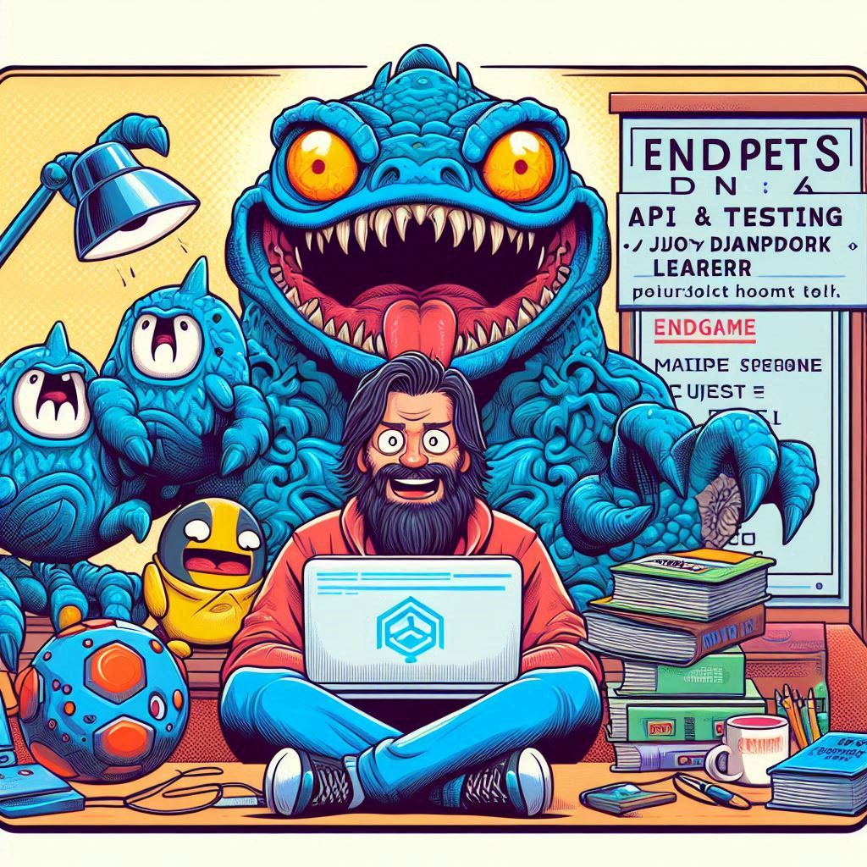
04
API Views & Models for NoSQL
Notes:
All the differences from relational db setup (sql_ex)
External db connection in code rather than settings.py (comment out database section)
Library required to interface with database, providing access controls/commands – pymongo
Using HttpResponse, JsonResponse serializers when no models
Nosql_ex project still uses rest_framework to structure the requests and adhere to REST principles more closely
Instead of using Viewsets which provide a simple low-code way to setup api views for crud functions, we’ll be using APIViews to provide more control
Since viewsets require serializers and rely heavily on the parent class, it becomes less convenient when using a non relational db
Comparison
APIViews for Granular Control:Full Customization: Every HTTP method can be customized in isolation.Non-CRUD Endpoints: Easier to implement endpoints that don't fit the standard CRUD pattern.Direct Use: You directly handle request and response objects.
ViewSets for Rapid Development and Consistency:Less Code for CRUD: Reduces boilerplate code for standard operations.Automatic Routing: Easily set up with DRF’s routers to automatically generate URLs.Standardization: Enforces a consistent pattern for CRUD operations.

Slide 30

Configure a NoSQL Database
To demonstrate how to configure NoSQL with Django we will be using MongoDB with the following dataset and field types listed below:
https://data.nasa.gov/Space-Science/Meteorite-Landings/gh4g-9sfh
- name: String
- id: Int32
- nametype: String
- recclass: String
- mass (g): String
- fall: String
- year: Int32
- reclat: Double
- reclong: Double
- GeoLocation: String
Log into Atlas create Mongo account: https://www.mongodb.com/atlas/database
Create a Free tier Shared Cluster called djangolab-cluster (default settings – AWS, Sydney).
You’ll be prompted to enter a username and password for the cluster user (not the same as MongoDB login credentials). This will be reflected in a provided connection string. Options to manage the cluster will be presented, choose to use Compass and it will download (https://www.mongodb.com/try/download/compass). Connect to the Atlas account with the connection string.
Access the Cluster in Atlas and go to ‘Collections’ tab – ‘add my own data’ to create your first database. Name it nasa_data_db, and the collection meteorite_landings.
In Compass, refresh and you should see the db, choose ‘create collection’ and import data. Choose the downloaded dataset. Use default settings, it should have ‘Comma’ as the delimiter. Ensure field types match.
The data should now be imported and viewable in both Atlas and Compass.
Speaking of craters, many of them were named after artists or authors who made significant contributions to their respective fields. Mercury takes a little more than 58 days to complete its rotation, so try to imagine how long days must be there! Since the temperatures are so extreme and the solar radiation is so high, Mercury has sadly been considered to be non-habitable for humans
from pptx import Presentation
Notes:
Once the database is setup and the data imported we can move our attention to Django to configure how we will communicate and interact with the db.
To setup a connection we require:
connection string – mongodb+srv://<username>:<password>@djangolab-cluster.y0zsa4f.mongodb.net/
database name – nasa_data_db
collection name – meteorite_landings
The ip you are accessing the db with needs to be added to Atlas under Network Access. NOTE that using a VPN can interfere with the connection and it is recommended to disable when testing this connection.

Slide 31
Object Mapping with NoSQL
No ORM - Pymongo
ORM - Djongo
ODM - MongoEngine
Jupiter is a gs giant and the biggest planet in the Solar System. It's the fourth-brightest object in the night sky and was named after the Roman god of the skies
Jupiter is a gs giant and the biggest planet in the Solar System. It's the fourth-brightest object in the night sky and was named after the Roman god of the skies
Saturn is a gas giant and has several rings. This planet is composed mostly of hydrogen and helium. It’s the sixth planet from the Sun and was named after a Roman god too
Notes:
No ORM implications – pros and cons of
ORM with NoSQL:
djongo library can provide object relational mapping, however adds an extra layer of abstraction, which can reduce some of the flexibility and performance benefits of MongoDB/schemaless nature of NoSQL
Not as mature or feature-rich as native ODMs like MongoEngine or direct use of PyMongo
ODM (Object-Document Mappers)
Using ODMs like MongoEngine can provide structure and data validation similar to ORMs for SQL databases, while still allowing some flexibility
ODMs can provide a more seamless integration with web frameworks like Django, including model validation and serialization
While using an ORM like Djongo can simplify development for those familiar with Django, it is more common in NoSQL databases to use direct access methods like PyMongo for the flexibility and performance benefits they offer. If you need the structured approach and benefits of Django's ORM, Djongo can be a good choice. Otherwise, direct access with PyMongo or using an ODM like MongoEngine might be more appropriate for taking full advantage of MongoDB's capabilities.

Slide 32

06
Start a New Project
Notes:
STARTING A NEW DJANGO PROJECT
- commands to create project and start server
- what the commands do
- django needs to be running server to access (has built in simple server that would be migrated to Apache/nginix for deployment)
1. Set Up the Project Directory
Create a directory for your project and navigate into it. This directory will hold all your project files.
mkdir my_project
cd my_project
## 2. Create and activate Python Virtual Environment
A virtual environment isolates your project’s dependencies, ensuring they do not conflict with other projects.
**Linux/Mac:**
python3 -m venv my_project_venv (Many modern Linux distributions have started to phase out Python 2, and in some cases, python may now point to python3. However, this behavior can vary by distribution so better to declare it explicitly)
source my_project_venv/bin/activate (make sure your in the project directory where the venv is installed.
**Windows:**
python -m venv my_project_venv
my_project_venv\Scripts\activate.bat
To deactivate the virtual environment (all platforms):
deactivate
## 3. Install Django
Install Django within the virtual environment. You can specify a version with the `~=` operator.
pip install django
## 4. Start a New Django Project
Create a new Django project named `config` in the current directory. The period (`.`) at the end specifies the current directory.
django-admin startproject config .
## 5. Create a Django App
A Django app is a module that handles specific functionality of your project. Create a new app named `main_app`.
python manage.py startapp main_app
## 6. Database Migrations
Django uses migrations to propagate changes you make to your models into your database schema.
**Create and apply migration files:**
These commands generate and apply the migration files based on the changes you made to your models.
python manage.py makemigrations (creates db.sqlite3 if not existing)
python manage.py migrate
## 7. Create a Superuser
The superuser account is used to access the Django admin panel, allowing you to manage your application.
python manage.py createsuperuser
Follow the prompts to set up the superuser account (username, email, password).
## 8. Start the Development Server
Run the Django development server to check if everything is set up correctly.
python manage.py runserver
Visit `http://127.0.0.1:8000` (or `http://localhost:8000`) in your browser to see your project.
## 9. Manage Project Dependencies
Creating a `requirements.txt` file helps you track your project’s dependencies, making it easier to install them later.
pip freeze > requirements.txt
## 10. Push to new repo
OPTIONAL STEPS TO INSTALL node.js and expo cli - FOR REACT DEVELOPMENT
Install nvm (Node Version Manager):
> curl -o- https://raw.githubusercontent.com/nvm-sh/nvm/v0.39.5/install.sh | bash
Reload your shell configuration:
> source ~/.bashrc
Install the latest Node.js version with the node version manager:
> nvm install node
Verify Node.js installation:
> node -v
Install Expo CLI:
> npm install -g expo-cli
Create a new Expo project:
> expo init project2

Slide 33
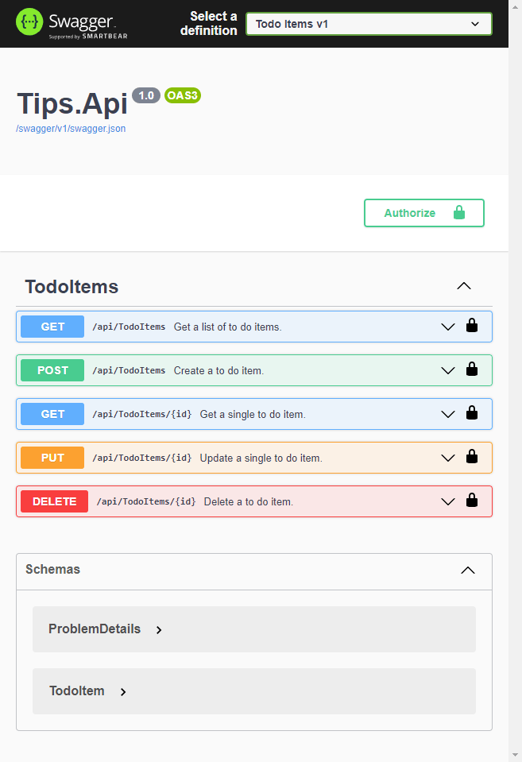

Learning Resources
Django Official:
https://docs.djangoproject.com/en/4.1/intro/tutorial01/ --→ deprecated
W3 Schools:
https://www.w3schools.com/django/
A python + django cheat sheet is available here:
https://dev.to/ericchapman/my-beloved-django-cheat-sheet-2056
Notes:
Django Official:
https://docs.djangoproject.com/en/4.1/intro/tutorial01/ --→ deprecated
W3 Schools:
https://www.w3schools.com/django/
A python + django cheat sheet is available here:
https://dev.to/ericchapman/my-beloved-django-cheat-sheet-2056

Slide 34
Command Cheat Sheet
Installing Dependencies
Creating New Project
Accessing Existing Repo
Jupiter is a gs giant and the biggest planet in the Solar System. It's the fourth-brightest object in the night sky and was named after the Roman god of the skies
# create Django project
django-admin startproject config .
# create app
# create superuser
# run server
python manage.py runserver
Saturn is a gas giant and has several rings. This planet is composed mostly of hydrogen and helium. It’s the sixth planet from the Sun and was named after a Roman god too
# install python stuff
sudo apt install python venv pip
# install ssh
sudo apt install openssh
# clone the existing repo
git clone https://github.com/<username>/<reponame>.git
# install requirements.txt
pip install -r requirements.txt
# make-a da migrations

Slide 35
Command Cheat Sheet
manage.py
sqlite
python
Jupiter is a gas giant and the biggest planet in the Solar System. It's the fourth-brightest object in the night sky and was named after the Roman god of the skies
# create Django project
django-admin startproject config .
# create app
# create superuser
# run server
python manage.py runserver
Saturn is a gas giant and has several rings. This planet is composed mostly of hydrogen and helium. It’s the sixth planet from the Sun and was named after a Roman god too
# install python stuff
sudo apt install python venv pip
# install ssh
sudo apt install openssh
# clone the existing repo
git clone https://github.com/<username>/<reponame>.git
# install requirements.txt
pip install -r requirements.txt
# make-a da migrations

Slide 36


Thanks!
Do you have any questions?
lukewait@outlook.com
https://github.com/LukeWait
LinkedIn/LukeWait

Slide 37






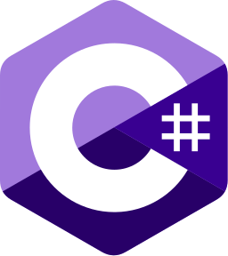
Popular Web Development Frameworks
Django | Ruby on Rails | Laravel | ASP.NET
Python | Ruby | PHP | C#
Example 1 Example 2 Example 3 | Example 1 Example 2 Example 3 | Example 1 Example 2 Example 3 | Example 1 Example 2 Example 3

Slide 38





Popular Front End Frameworks
React | React Native | Flutter | Ionic
JavaScript | JavaScript | Dart | ??
Example 1 Example 2 Example 3 | Example 1 Example 2 Example 3 | Example 1 Example 2 Example 3 | Example 1 Example 2 Example 3

Slide 39
You can divide the content
Mercury
Venus
Mercury is the closest planet to the Sun and the smallest one in the Solar System—it’s only a bit larger than the Moon. This planet’s name has nothing to do with the liquid metal, since Mercury was named after the Roman messenger god
Venus has a beautiful name and is the second planet from the Sun. It’s terribly hot—even hotter than Mercury—and its atmosphere is extremely poisonous. It’s the second-brightest natural object in the night sky after the Moon

Slide 40
Divide the content into four ideas
Mars
Venus
Despite being red, Mars is actually a cold place. It’s full of iron oxide dust, which gives the planet its reddish cast, and it’s made of basalt
Venus has a beautiful name and is the second planet from the Sun. It’s terribly hot and its atmosphere is extremely poisonous
Jupiter
Saturn
Jupiter is a gas giant and the biggest planet in the Solar System. It’s the fourth-brightest object in the night sky and was named after a god
Saturn is a gas giant and has several rings. It’s composed mostly of hydrogen and helium. It’s the sixth planet from the Sun

Slide 41
Reviewing concepts is a good idea
Mars
Venus
Neptune
Despite being red, Mars is actually a cold place. It’s full of iron oxide dust, which gives the planet its reddish cast
Venus has a beautiful name and is the second planet from the Sun. It’s terribly hot, even hotter than Mercury
Neptune is the farthest planet from the Sun. It’s also the fourth-largest planet by diameter in the Solar System
Earth
Saturn
Jupiter
Earth is the third planet from the Sun and the only one in the Solar System that harbors life. We all live on this planet
Saturn is a gas giant and has rings. It's composed mostly of hydrogen and helium. It’s the sixth planet from the Sun
Jupiter is a gas giant and the biggest planet in the Solar System. It’s the fourth-brightest object in the night sky

Slide 42
You can use five columns
Mars
Venus
Despite being red, Mars is actually a cold place. It’s full of iron oxide dust
Venus has a beautiful name and is the second planet from the Sun
Mercury
Saturn
Jupiter
Mercury is the closest planet to the Sun and the smallest of them all
Saturn was named after the Roman god of wealth and agriculture
Jupiter is a gas giant and the biggest planet in the Solar System

Slide 43
Command Cheat Sheet
Installing Dependencies
Creating New Project
Accessing Existing Repo
Jupiter is a gs giant and the biggest planet in the Solar System. It's the fourth-brightest object in the night sky and was named after the Roman god of the skies
Jupiter is a gs giant and the biggest planet in the Solar System. It's the fourth-brightest object in the night sky and was named after the Roman god of the skies
Saturn is a gas giant and has several rings. This planet is composed mostly of hydrogen and helium. It’s the sixth planet from the Sun and was named after a Roman god too

Slide 44
Conclusion
Venus
Mars
You can write the details here
You can write the details here
You can write the details here
You can write the details here
You can write the details here
You can write the details here
You can write the details here
You can write the details here
You can write the details here
You can write the details here
You can write the details here
You can write the details here
You can write the details here
You can write the details here
You can write the details here
You can write the details here

Slide 45
A timeline always works well
Step 1
Step 2
Step 3
Step 4
Venus is a hot planet
Mercury is very small
Mars is made of basalt
Jupiter is a gas giant
Step 5
Step 6
Step 7
Step 8
Saturn has rings
The Sun is a star
Earth harbors life
Neptune is an ice giant

Slide 46
Anticipated industry changes
Step 1
Step 2
Step 3
Step 4
Earth is the only planet known to harbor life
Despite being red, Mars is actually a cold place
Jupiter is the biggest planet in the Solar System
Saturn has a high number of moons, like Jupiter

Slide 47
Frameworks for implementation
Neptune
Neptune is the farthest planet from the Sun
Jupiter
Jupiter was named after a Roman god
Digital Transformation
Mercury
Mercury is the closest planet to the Sun
Venus
Venus is the second planet from the Sun

Slide 48
Components of a Web Dev Framework
Backend
A
B
Front End
Model
C
D
Views
Django
Database
E
F
URLs
APIs
G
H
UI/UX

Slide 49
Impact on industries
Venus
Neptune
Venus is the second planet from the Sun
It’s the biggest planet in the Solar System
Jupiter
Saturn
Jupiter doesn’t have a solid surface
Saturn is a gas giant and has several rings
Earth
Mars
Earth is the only planet that harbors life
Despite being red, Mars is actually a cold place

Slide 50
Use tables to represent data
 | Team A | Team B | Team C | Team D | Team E | Team F
Mercury | XX | XX | XX | XX | XX | XX
Mars | XX | XX | XX | XX | XX | XX
Saturn | XX | XX | XX | XX | XX | XX
Venus | XX | XX | XX | XX | XX | XX
Jupiter | XX | XX | XX | XX | XX | XX
Earth | XX | XX | XX | XX | XX | XX
Pluto | XX | XX | XX | XX | XX | XX

Slide 51
Let’s use some percentages
25%
50%
75%
Mercury
Venus
Mars
Mercury is the closest planet to the Sun and the smallest one of them all
Venus has a beautiful name and is the second planet from the Sun
Despite being red, Mars is actually a cold place. It’s full of iron oxide dust

Slide 52
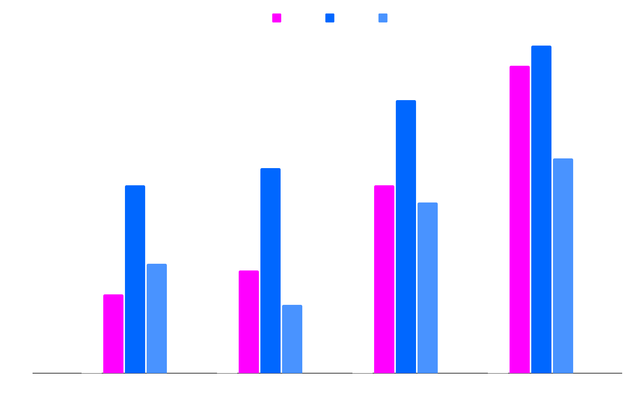
Popular Front End Frameworks
Team 1
Team 2
Team 3
Team 4
Follow the link in the map to modify its data and then paste the new one here. For more info, click here

Slide 53

You can use another graph
10%
30%
Venus
Jupiter
Venus is the second planet from the Sun
It’s the biggest planet in the Solar System
40%
20%
Mars
Saturn
Despite being red, Mars is a cold place
Saturn is a gas giant and has several rings
Follow the link in the map to modify its data and then paste the new one here. For more info, click here

Slide 54


Our team
Sofia Hill
John Harris
You can speak a bit about this person here
You can speak a bit about this person here

Slide 55
— Someone Famous
“This is a quote, words full of wisdom that someone important said and that can inspire the reader”

Slide 56
Awesome words

Slide 57

A picture always reinforces
the concept
Images reveal large amounts of data, so remember: use an image instead of a long text. Your audience will appreciate it

Slide 58
98,300,000
Big numbers catch your audience’s attention

Slide 59

9h 55m 23s
333,000
386,000 km
Jupiter’s rotation period
The Sun’s mass compared to Earth’s
The distance between Earth and the Moon

Slide 60
Contents of this template
You can delete this slide when you’re done editing the presentation
Fonts | To view this template correctly in PowerPoint, download and install the fonts we used
Used and alternative resources | An assortment of graphic resources that are suitable for use in this presentation
Thanks slide | You must keep it so that proper credits for our design are given
Colors | All the colors used in this presentation
Icons and infographic resources | These can be used in the template, and their size and color can be edited
Editable presentation theme | You can edit the master slides easily. For more info, click here
For more info: SLIDESGO | BLOG | FAQs
You can visit our sister projects: FREEPIK | FLATICON | STORYSET | WEPIK | VIDEVO

